Slide 1
Process Synchronization

Slide 2
Process Types
Independent Process:
The execution of one process does not affect the execution of other processes.
Cooperative Process:
A process that can affect or be affected by other processes executing in the system.
Process Types
Independent Process
Cooperative Process
Process synchronization problem arises in the case of Cooperative process because resources are shared in Cooperative processes.

Slide 3
Cooperating Processes
Concurrent access to shared data may result in data inconsistency.
Maintaining data consistency requires mechanisms to ensure the orderly execution of cooperating processes
Co-operating Process
Directly share common address space (Code and data area)
Allowed to share data only through files or messages

Slide 4
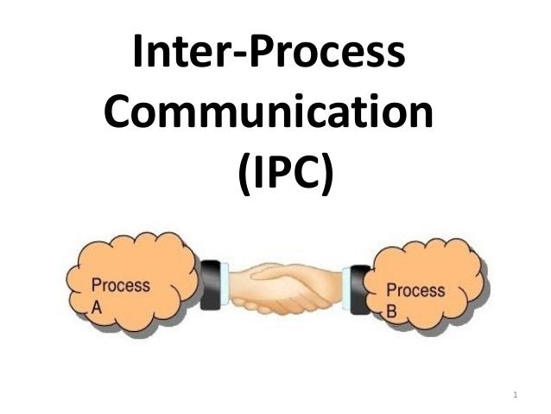
Inter Process Communication (IPC)
Inter-process communication (IPC) is a mechanism that allows processes to communicate with each other and synchronize their actions.
The communication between these processes can be seen as a method of co-operation between them.

Slide 5
Inter Process Communication (IPC)
Useful in a distributed environment
The processes may reside on different computers connected with a network.
A chat program used on the World Wide Web.
Shared Memory
Message Passing

Slide 6
Shared Memory Vs Message Passing

Slide 7
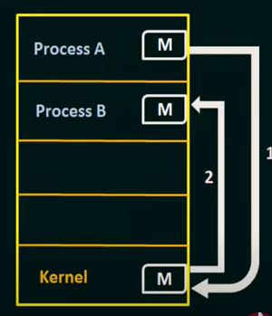
Message Passing
Communicate and synchronous without sharing the same address space.
Suitable if communicating processes are in different systems connected through network.

Slide 8
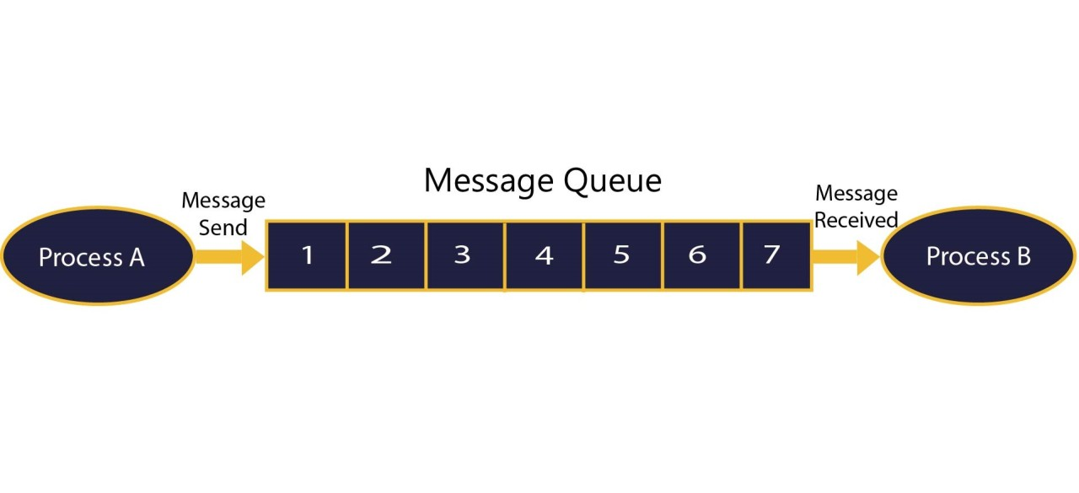
Message Passing
Send Message
Receive Message

Slide 9
Direct Communication
With direct communication, each process that wants to communicate must explicitly name the recipient or sender of the communication.
send(P, message) – Send a message to process P
receive(Q, message) – Receive a message from process Q
Communication link in this scheme has the following properties:
A link is established automatically between every pair of processes that want to communicate.

Slide 10
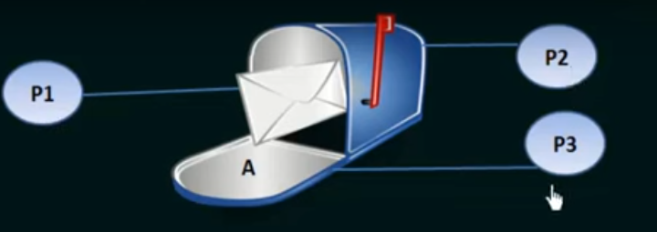
Indirect Communication
The messages are sent to and received from mailboxes, or ports which messages can be placed by processes and from which messages can be removed.
Each mailbox has a unique identification.
A process can communicate with some other process via a number of different mailboxes.

Slide 11
Race Condition
P1
{
----
---
Count++
}
P2
{
----
---
Count--
}
P1
MOV count, R0
Increment R0
MOV R0, count
P2
MOV count, R0
Decrement R0
MOV R0, count
Count
5
Count
5
Order of execution→P1:1,2,3 P2: 1,2,3
Order of execution→P1:1,2 P2: 1,2 P1: 3 P2:3

Slide 12
Race Condition
P1
MOV count, R0
Increment R0
MOV R0, count
P2
MOV count, R0
Decrement R0
MOV R0, count
Final output produced depends on the order of execution.
A situation like this, where several processes access and manipulate the same data concurrently and outcome of execution depends on the order of execution , is called race condition
Count
5
Order of execution→P1:1,2,3 P2: 1,2,3
Order of execution→P1:1,2 P2: 1,2 P1: 3 P2:3

Slide 13
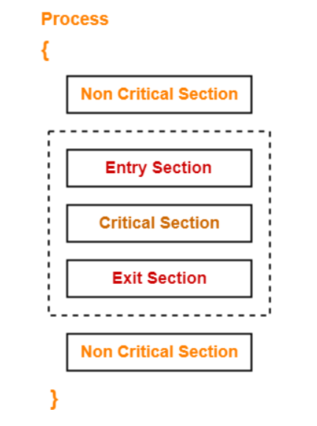
Critical Section Problem
Consider a system containing processes {P1,P2, ….Pn}
Each process has a segment of code called critical section.
The code segment in critical section is responsible for making a change in common shared variables, writing to a file, updating a table etc…

Slide 14
Critical Section Problem
Each process must request permission to enter its critical section.
The section of code implementing this request is the entry section.
Critical section is then followed by an exit section.
The remaining code is the remainder section.

Slide 15
The Critical Section Problem
Mutual Exclusion: If a process is executing in its critical section, then no other process is allowed to execute in the critical section.
Progress: If no process is executing in the critical section and other processes are waiting outside the critical section, then only those processes that are not executing in their remainder section can participate in deciding which will enter in the critical section next, and the selection can not be postponed indefinitely.

Slide 16
The Critical Section Problem
Bounded Waiting: A bound must exist on the number of times that other processes are allowed to enter their critical sections after a process has made a request to enter its critical section and before that request is granted.

Slide 17
Semaphore
Proposed by Edsger Dijikstra
To manage concurrent processes using a single integer value.
A non negative integer variable shared between threads/processes.
A semaphore ‘S’ is a variable and its value can be accessed only by two standard atomic operations called wait() and signal()
wait () →P → to test
Signal() → V → to increment

Slide 18
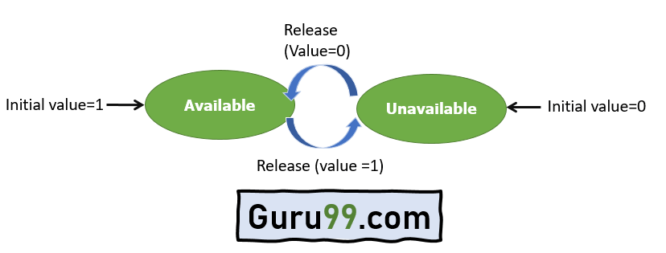
Types of semaphore
BINARY Semaphore
In these type of Semaphores the integer value of the semaphore can only be either 0 or 1.

Slide 19
Types of semaphore
COUNTING Semaphore
Counting semaphores are signalling integers that can take on any integer value.
Using these Semaphores we can coordinate access to resources and here the Semaphore count is the number of resources available.
Counting semaphores are generally used when the number of instances of a resource are more than 1, and multiple processes can access the resource.

Slide 20
Semaphore
Definition of wait()
P ( semaphore s)
{
while (s <=0);
s--;
}
Definition of signal()
V ( semaphore s)
{
s++;
}

Slide 21
Semaphore
sem_t s; To declare a semaphore variable
sem_init(sem_t *s,int pshared,unsigned int value) → To initialize a semaphore variable. (address of semaphore variable, pshared =0 if sharing in threads, 1 if sharing in processes, initial value of variable)
Eg: Sem_init(&s,0,1)
sem_wait(&s) – to implement wait(s)
sem_post(&s) - to implement dignal(s)
Sem_destroy(&s) → to destroy semaphore variable

